Slide 1
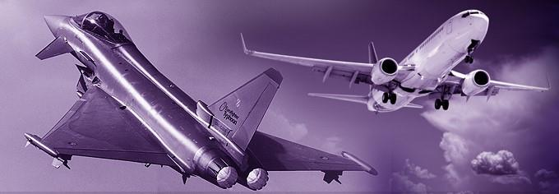
Company Presentation
Specialists in interconnecting solutions

Slide 2
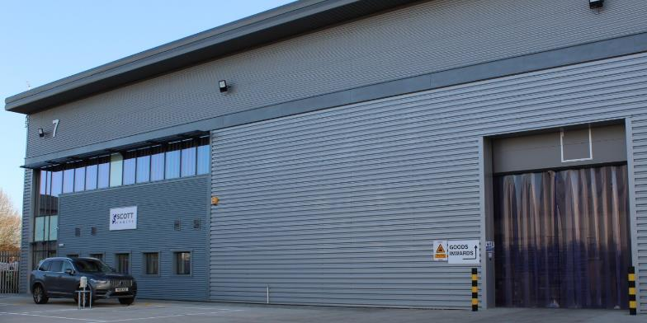
Key Facts
Established in 1991
Originally named Select Enterprises before rebranding as Select Cables and then more recently Scott Cables in 2012.
Privately owned & independent
Financially secure
New 15,000sqft (1,400m²) facility
UK Manufacturing
Experienced Team
Respected within the industry

Slide 3
Approvals
ISO9001/AS9100 Rev D – Quality Management System
ISO14001 – Environmental Management System
IPC/WHMA-A-620 Trained Production Staff
IPC/WHMA-A-620 Certified Trainer
Cyber Essentials accreditation
JOSCAR accreditation
Approved UK MOD Supplier
Ship-to-Stock status at major OEMs

Slide 4
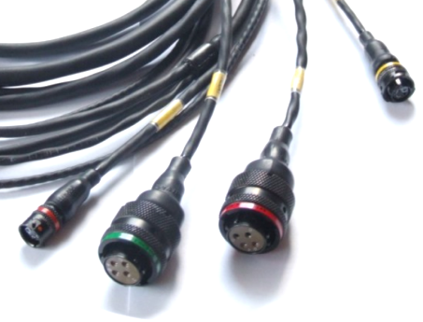
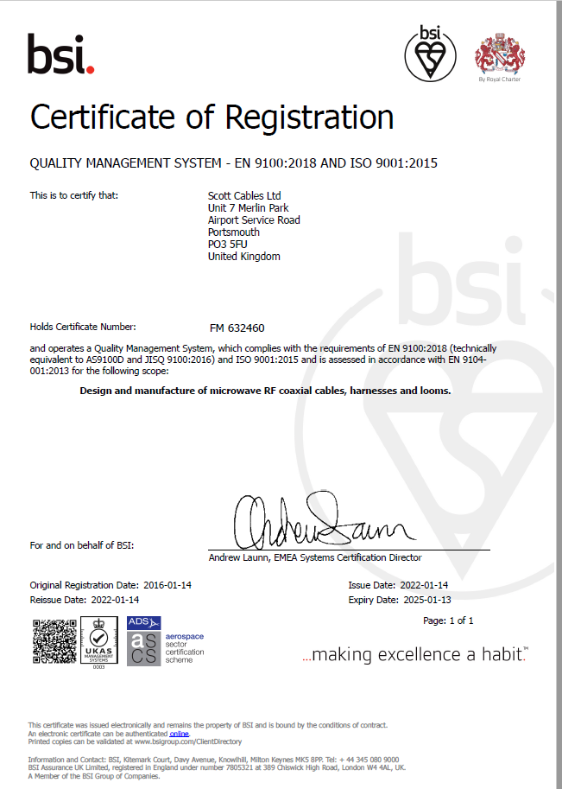
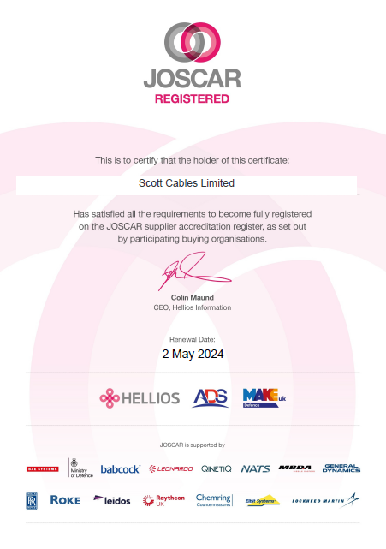
Accreditations

Slide 5
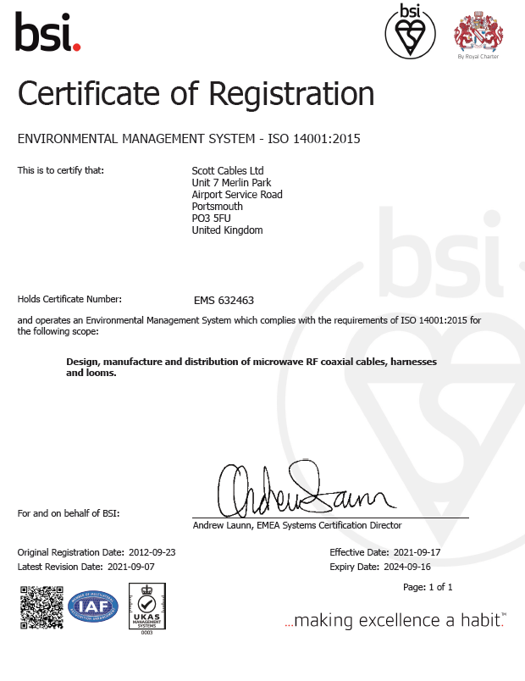
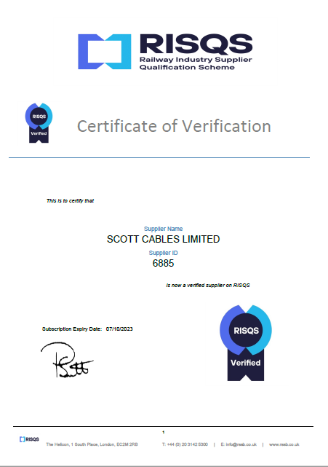
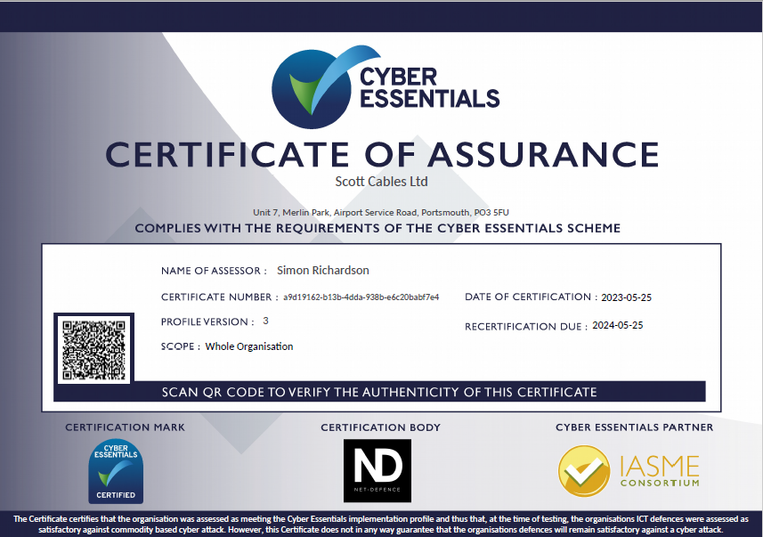
Accreditations Contd.

Slide 6
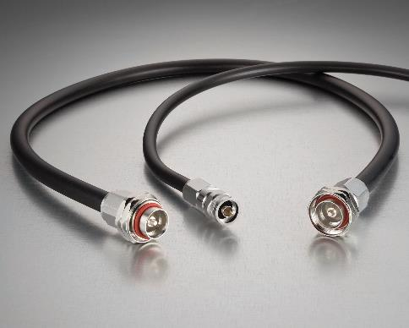
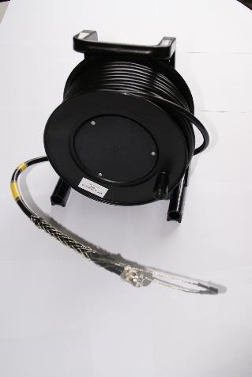
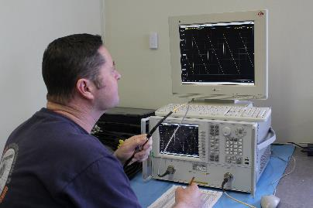
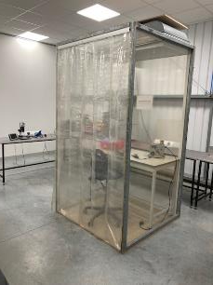
Capabilities
Electrical Cable Assemblies
RF/Microwave Cable Assemblies
Electro-Mechanical Assemblies
Test Cables
Supply of Wide Range of RF Connectors
Clean Room Capability
Supply of EMI & RFI Cable Shielding
Supply of Mil-Std Circular & Rectangular Connectors
Supply of Optical Cable Assemblies for High Integrity and Harsh Environment applications
Design Support
Stock & Distribution
Onsite Support
Toolroom for creation of bespoke fixtures and jigs

Slide 7
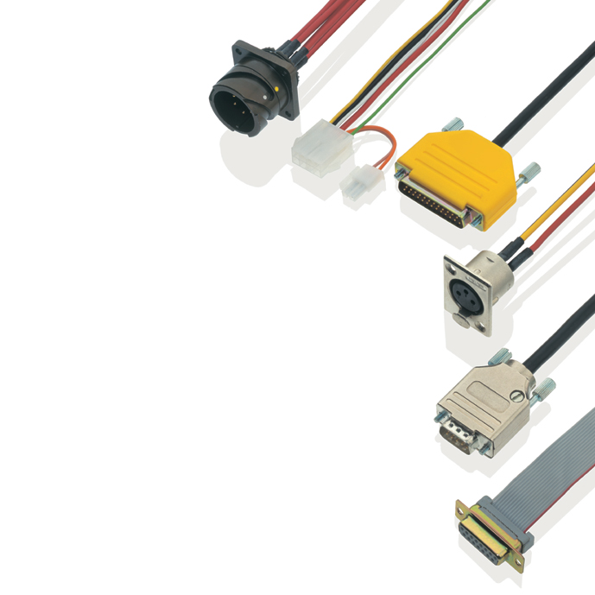
Electrical Cable Assemblies
Wiring Harnesses/Looms
Power & Data Applications
Heatshrink, Conduit, Ty-wrap, Laced, Taped bundling methods
Ribbon Cables
Earth Braids
EMI/RFI Shielding
Connector Systems - Circular, Rectangular, D-Type, IDC
Deployable Cable Reels
Bespoke Multicores

Slide 8
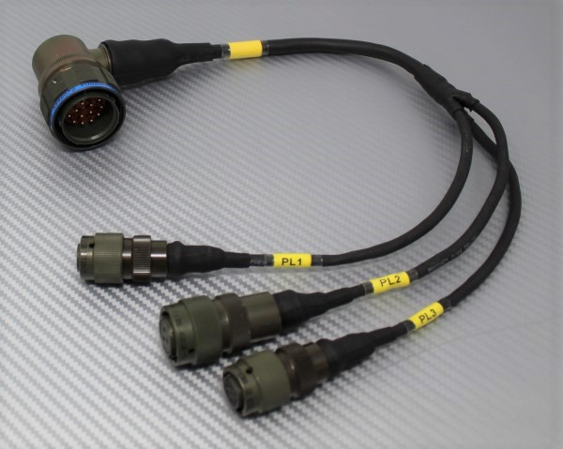
Electrical Cable Assemblies
Sealed Wiring Harnesses
Typical construction for harsh environment military and aerospace applications.
Sealed using heat-shrink tubes and moulded parts.
Connector systems are usually circular military specification e.g. D38999
Internal wires are usually electrically screened using braid or foil wrap.

Slide 9
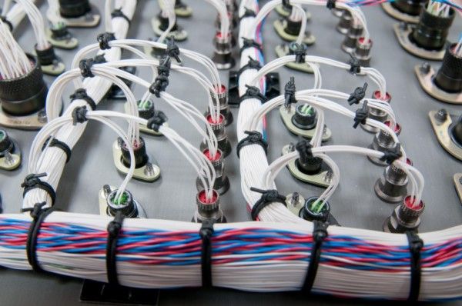
Electrical Cable Assemblies
Open Wiring Harnesses
Typical construction for internal applications.
Wires bundled together using cable ties, lacing cord or tape.
Connector systems can be circular, rectangular or D-type.
Electrical screening still possible on signal wires/twisted pairs.

Slide 10
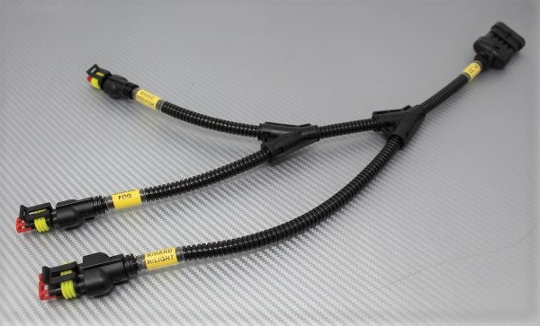
Electrical Cable Assemblies
Closed Wiring Harnesses
Typical construction for external applications.
Industrial applications but also used in non-critical military applications.
Connector systems are typically plastic variants.
Electrical screening may not be required.

Slide 11
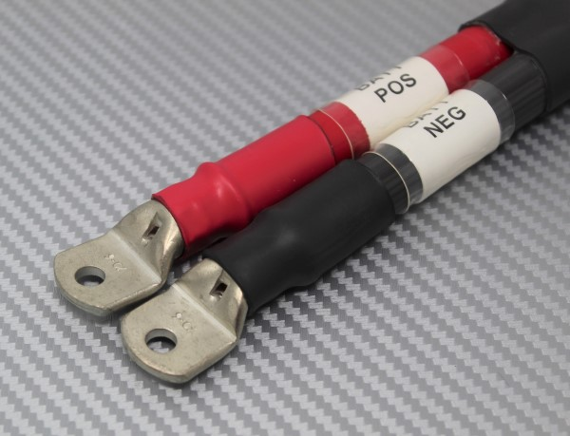
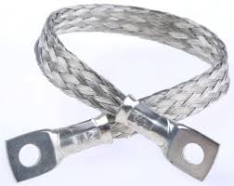
Electrical Cable Assemblies
Power Leads & Battery Cables
Used in a range of Power applications.
Low voltage and high voltage cables.
Cable sizes up to 150mm².
Braided earth straps also provided.

Slide 12
Electrical Cable Assemblies
Deployable Cable Reels
Long length cable assemblies supplied on a reel or drum.
Bespoke cable constructions can be provided giving the customer the precise number and size of inner wires they require.
Outer cable insulation selected to suit the environment.

Slide 13
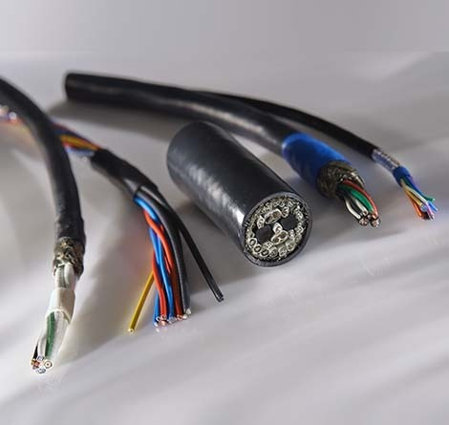
Electrical Cable Assemblies
Bespoke Multicore Cables
Cable assemblies can be provided to give the customer the precise number, size, colour and specification of internal wires.
Bespoke cable constructions can be hand-built using individual wires, braided screens and heat-shrink outer jacket.
For higher volume requirements, bespoke multicore cables can be machine built with extruded outer jackets.

Slide 14
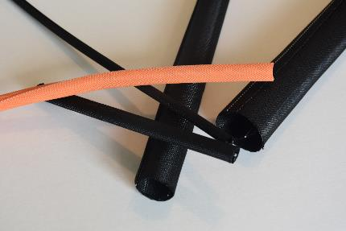
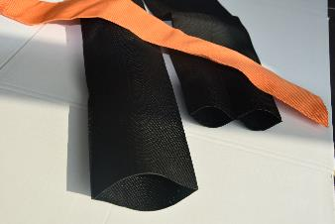
Abrasion Resistant Materials
Supply of Abrasion Resistant Materials from Fitco
Range of solutions ideal for offering protection of cable products arising from conditions such as vibration, friction and abrasion
Products are suitable for use in numerous applications across a wide range of industries including Military, Aerospace, Industrial, Transportation and Automotive
Temperature range -50°C to +150°C
Fire retardant materials available

Slide 15
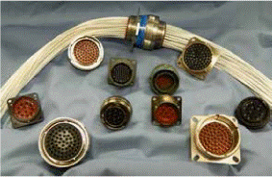
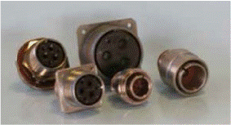
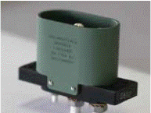
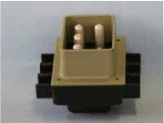
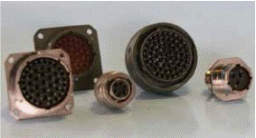
Mil-Std Circular & Rectangular Connectors
Supply of Mil-Std Circular & Rectangular Connectors from Corsair Electrical Connectors
The range of products include:
MIL-DTL-38999 (Series I, II & III)
MIL-DTL-5015 (Series II & II)
MIL-DTL-26482 (Series 2)
MIL-DTL-83723
MIL-DTL-81790
MIL-DTL-39029 – inc. Thermocouple Contacts
AS81790 - Ground Power Receptacles

Slide 16
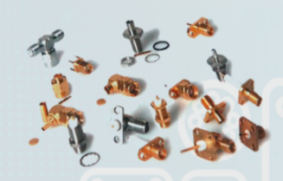
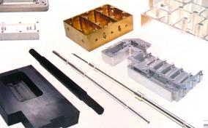
Range of Cable & PCB Connectors
Supply a full range of RF Connectors from C M srl
CM srl offer Coaxial Connector for a wide range of cable types and can supply both standard off the shelf parts and bespoke connector solutions including mixed signal, multi-way connectors.
CM srl can offer cost effective solutions for a wide range of industries including Military, Telecoms, Broadcast, Industrial and Medical
This partnership with CM srl enhances Scott Cables Cable Assembly offering
CM srl specialise in the supply of machined parts including housings for filters and antennas. With over 50 CNC Lathes, parts can be produced from a wide range of metals (Brass, Steel, Aluminium, Bronze and Beryllium Copper) and plastics (PTFE (Teflon), POM (Delrin), Rexolite, Ultem and Polycarbonate (Lexan))

Slide 17
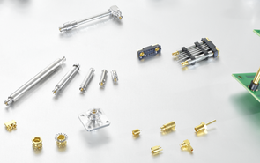
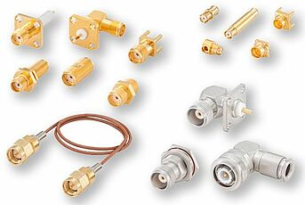
Range of Cable & PCB Connectors
Supply a full range of RF Connectors from Rosenberger
Scott Cables have a working relationship with Rosenberger meaning we can provide a wide range of both cable and PCB Connectors
Wide range of Connector series available
Full SMP Range (SMPM though to SMP)
SMA, TNC, N-Type, 7/16th, 4.3-10 & NEX-10 to name a few
High Frequency Connectors – 3.5mm, 2.92mm, 2.4mm, 1.85mm & 1mm
Board to Board Solutions available.

Slide 18
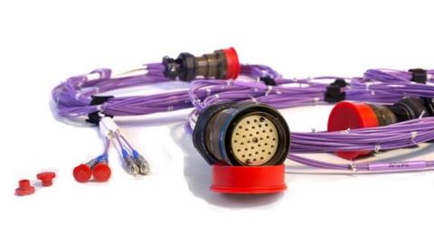
Optical Cable Assemblies for Harsh Environments
Supply of Optical cable assemblies from AVoptics Ltd.
Specialist products to support High Integrity applications
Suitable for harsh environments
All operators IPC Trained and Certified
AS9100 rev C accredited
UK Design and Manufacturing facility
Expertise is using optical cable/connector types including A801, Elio, LuxCis, MT, Mil-C-38999, TFOCA, MC3, HA, M83526, JN1008B-LA

Slide 19
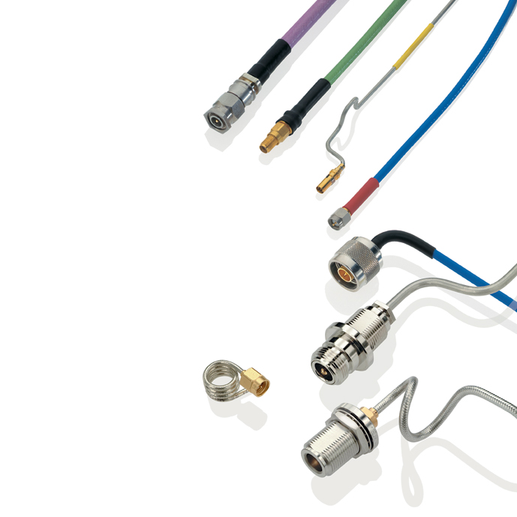
RF/Microwave Cable Assemblies
Flexible RF Cable Assemblies – Wide performance range of cables utilising cable types such as LMR, FBT and Low and Ultra-Low Loss cable types up to 70GHz
Semi-Rigid Microwave Cable Assemblies – European Distributor for EZ Form Cable
Phase Matched (or Delayed if required)
100% Tested with plots submitted upon request
High Performance to 70GHz
Industry standard cable & connectors held in-stock
Automated Cable Preparation
High volumes
Reduced build times (lower cost)

Slide 20
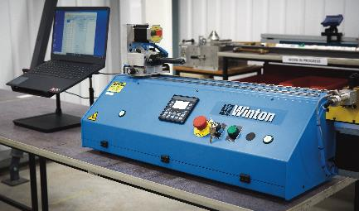
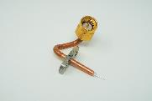
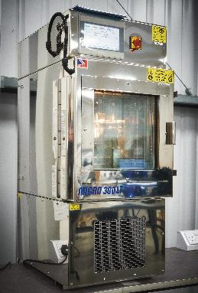
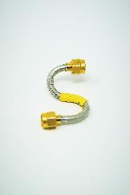
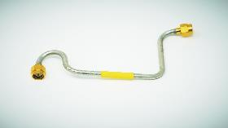
Semi-Rigid Capability
Semi-Rigid Auto Programmable Bend Former
Thermal Chamber for Conditioning of Semi-Rigid Cables

Slide 21
Cable Types Offered
RF Cable Assemblies – to 70GHz
Flexible alternatives to Semi-Rigid (0.047”, 0.085”, 0.141” & .250” sizes)
Low & Ultra Low loss Cables with diameters from .5” to .480”
Phase Stable over Temperature Non Teflon based Dielectric
Available both in Flexible and Semi-Rigid Formats
Armoured cable options available
Extensive range of products utilising LMR cables
Full range of both Hand Formable and full Semi-Rigid cable types from .034” to 0.250”
Cables utilising Low Loss dielectric materials available
Special Waterproof options available

Slide 22
Typical Connector Types
Comprehensive range of connectors available for all cable types
Work with wide range of RF Connector manufactures
Can offer Brass or Stainless Steel variants of connectors
Straight, Right Angle, Bulkhead and Flanged types available
Connector types including BNC, N, TNC, SSMA, SMA, SMC, SSMC, SMP, SSMP, BMA, 7/16, 4.3-10, NEX-10, 3.5mm, 2.92mm & 2.4mm
Waterproof options available

Slide 23
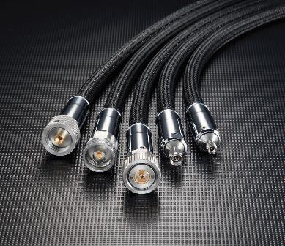
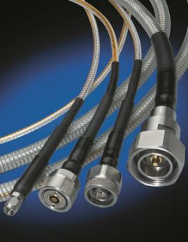
RF Test Cables
Microwave Test Cables for RF applications
Up to 110GHz
Long Flex Life
Phase & Loss Stable
Times Microwave series:
Silverline
Silverline SF
Silverline XF
Silverline VNA
Clarity

Slide 24
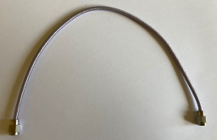
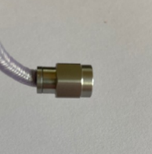
ScottFlex Cable Assemblies
Range of Cable Assemblies which can be bent directly behind the connector
No need for R/A connectors as cable can be bent behind the connector
Currently Available in 2 Cable sizes, .086 and.141
Available with custom manufactured lengths
Frequency range of DC to 26.5GHz
Available with SMA connectors from stock
Possibility of supplying other connector types

Slide 25
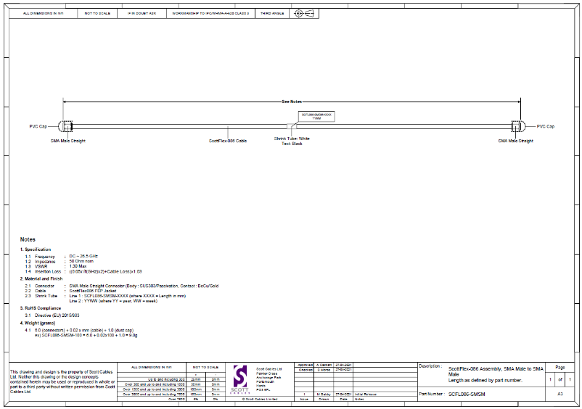
ScottFlex Cable Assemblies
ScottFlex .085

Slide 26
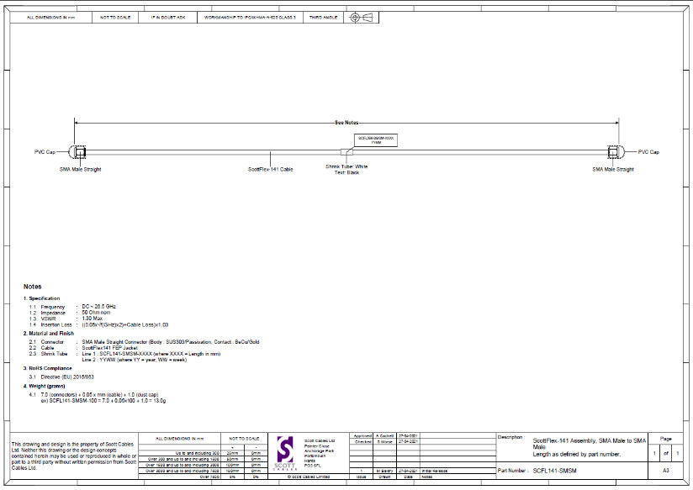
ScottFlex Cable Assemblies
ScottFlex .141

Slide 27
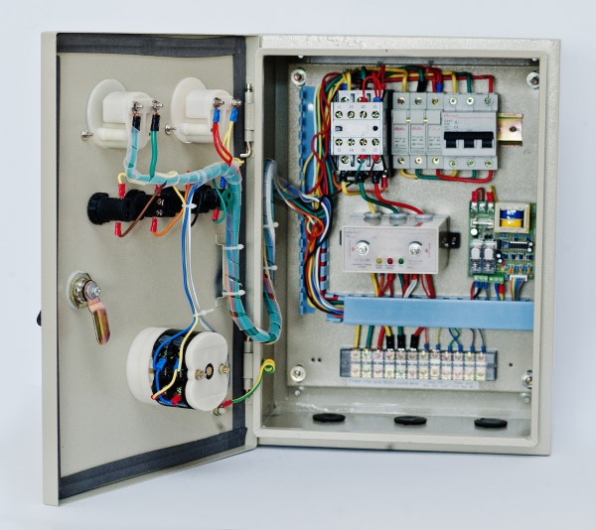
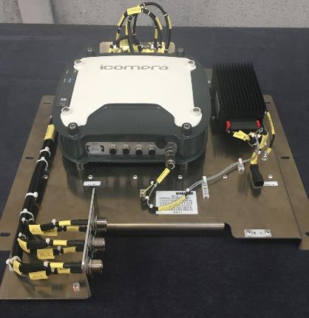
Electro-Mechanical Assemblies
Box-Builds
Control Panels
Sub-Assemblies
Distribution Units
PCB Enclosures
Metal and Plastic Housings

Slide 28
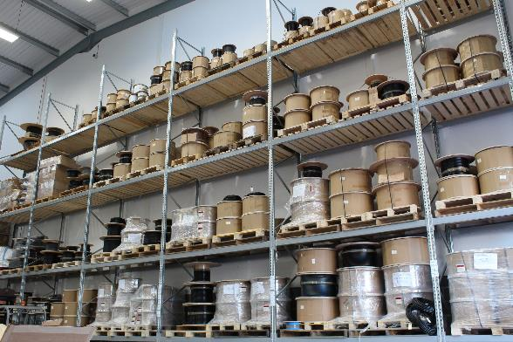
Stock & Distribution
European Master Distributor for Times Microwave Systems, AC Tasarim & EZ-Form
Strategic relationship with Rosenberger
Vast range of RF Cable, Connector, and EMI/RFI Shielding stock
Preferential Pricing
Industry standard product ranges
LMR
FBT
TCOM
Quick Quotation Turnaround
Reduced Lead-times

Slide 29
Stock & Distribution
Distributor for a range of Suppliers supporting the Interconnect Industry:

Slide 30
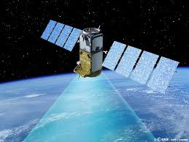
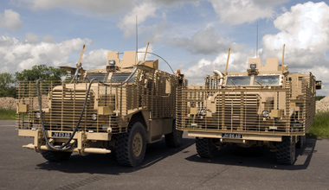
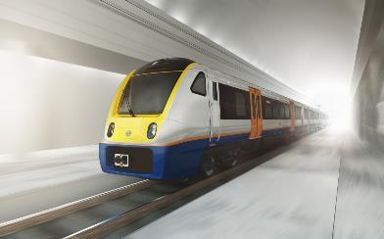
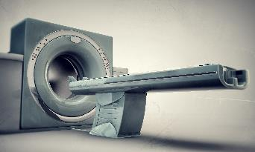
Market Sectors
Military & Defence
Aerospace
Space
Rail (Transport & Infrastructure)
Industrial
Telecommunications & Broadcast
Specialist Automotive
Energy
Medical

Slide 31
Military & Defence
Military Vehicles
C4i Systems
Soldier Technology
Weapon Systems
Military Aerospace
Naval Applications

Slide 32
Example Applications – Military Vehicles
RF Assemblies for Antennas and System interconnects
38999 Multi-Signal Interconnect Solutions i.e. Data, Power and RF
Ruggedized Ethernet Assemblies
Electrical Battery Cables and Earth straps

Slide 33
Example Applications – Radar & Defensive Aids
High performance interconnects for Radar Systems including High Frequency and Phase/Length Matched
- RF and Data Interconnects for Jamming systems both Vehicular and Portable Man packs & Anti-Drone systems
- Full range of interconnects for Missile Systems

Slide 34
Example Applications – Comms Systems
- Power, Data & RF Solutions for Military Shelters
- RF and Data Solutions for Military Man pack radios
- Power, Data & RF Solutions for C4ISR Systems

Slide 35
Example Applications – Test Systems
RF Cable Assemblies for:
Interconnects for Test Rack Systems
High performance Assemblies for Anechoic Chambers
RF Test Systems
High Performance Assemblies for Cryogenic applications

Slide 36
Example Applications – Space Industry
Wide range of assemblies suitable for LEO high volume space applications
- Power Cables - Data Harnesses - RF Assemblies
Assemblies for Satellite Test Systems
RF Phase Matched
High Performance, Flexible Low Loss RF
Semi-Rigid
RF Assemblies suitable for Thermal-Vac Chambers
Flexible and Semi-Rigid RF Assemblies using non Teflon Dielectrics i.e. phase stable over temperature
Silicon-Dioxide (SiO2) Cable Assemblies
Multi-Way, Multi-Signal Data Harnesses

Slide 37
Why Scott Cables?
Quality Performance
Delivery Performance
Quick Quotation Turnaround
Responsive
Flexible
Friendly
Reliable
Knowledgeable
Competitive

Slide 38
Why Scott Cables?
Scott Cables – Company Video
Company Video

Slide 39
Why Scott Cables?
Modern, spacious manufacturing facilities

Slide 40
Why Scott Cables?
Test and Inspection capabilities for all types of assemblies

Slide 41
Why Scott Cables?
Large stocks of Raw Cable and Connectors with accurate cable cutting capabilities

Slide 42
Thank You
Specialists in interconnecting solutions
www.scottcables.com

